Slide 1
Module 4: Training, Implementation, Operation & Maintenance
HP-II Workshop on Real-time Hydrological Information Systems
Mark Heggli, Meteorologist/Hydrologist
Expert Real-time Hydrology Information Systems
Innovative Hydrology, Inc.
Consultant to the World Bank

Slide 2
Examples that refer to products are intended for illustrative purposes only, and do not imply an endorsement or recommendation of any particular product

Slide 3
Importance of Training

Slide 4
Training: Important Elements
Develop several In-House Experts for the HIS whether or not you will be Maintaining the HIS
Expert in Field Equipment
Data Loggers
Sensors
Telemetry
Expert in Data Center Operations
Software Applications
WEB Interface
This is a Substantial Investment. Get Involved. Commit to Success and Excellence.

Slide 5
Training:
Training is critical for the long term success of the network
Training Strategy should include:
Documentation
Multi-media modules so training can be reviewed or taken by new employees
Important to train those assigned the task to maintain the network

Slide 6
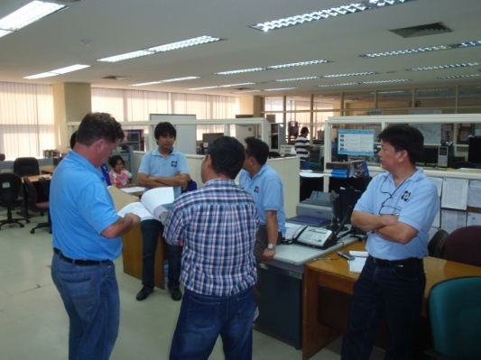
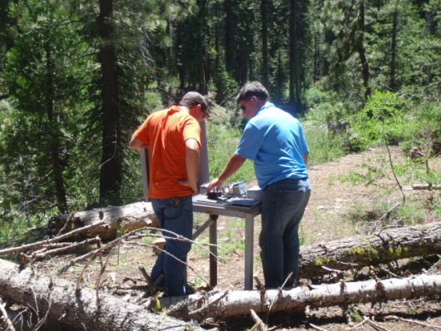
Training: Types
On-site Training
Field Equipment Training
Training
Documentation
Multi-Media Training

Slide 7
Training: Bidders Requirements
Provide an extensive training program for the system
Provide an outline or table indicating the contents of each of the required courses
Specific topics to be covered for each day of the training period
Training program included with the bid
The bidder is responsible for the salaries of the training instructors and all training materials
The costs of travel, transportation and per diem for the trainees shall be borne by the Bidder

Slide 8
Training: Strategy for Sustainability
Onsite training should take place at customers facilities
Training in general equipment operation and maintenance procedures will be provided by a training course as well receiving on-the-job training
There should be a multi-media training package comprised of modules that can be reviewed at any time desired by your Department

Slide 9
Training Topics: Field Equipment
Sensor handling and troubleshooting
Sensor calibration and troubleshooting
Data logger configuration
Data logger troubleshooting
Data downloading
Telemetry setup and troubleshooting
Charging System (Battery/Regulator/Solar Panel)
Importance of Grounding
Care and Maintenance of Instrument Shelter/Gauge House
Importance of Maintenance Logs and using Electronic Maintenance Tracking

Slide 10
Training Topics: Data Center and Information Systems
Server Operation & Maintenance
Data Collection Software Configuration and Operation
Database Maintenance
Quality Control Software Configuration and Operation
WEB Product Suite Configuration and Operation
Tabular Output
Graphical Output
Map Output
Downloading Data
Alarm Features

Slide 11
Training Topics: Hydrography
Safety Issues in performing stream gauge measurements
Performing stream gauge measurements using:
Mechanical Current Meter
Profiling ADCP
Gauge Height – Discharge relationship Review
Working up your gauge height discharge record with a time series database

Slide 12
Training Topics: Multi-Media Content
Module 1
Data collection platform programming, configuration, installation and maintenance. This will be a complete instructional video on the operation and maintenance of the Data Collection Platform, including examples using sensors and telemetry.
Minimum Suggested time: 4 hours

Slide 13
Training Topics: Multi-Media Content
Module 2
Sensor description, operation and maintenance. Examples showing step by step care and handling of the sensor, necessary maintenance, calibration, and operational facets.
Minimum Suggested Time: 4 hours

Slide 14
Training Topics: Multi-Media Content
Module 3
Receive station operation. Step by step procedures on how to program the ground station to collect data, program data collection platforms remotely.
Minimum Suggested time: 4 hours

Slide 15
Training Topics: Multi-Media Content
Module 4
Data validation and dissemination module. Step by step explanation on how to configure and use the data validation module. Include live examples using the software.
Minimum Suggested Time: 6 hours

Slide 16
Training Topics: Multi-Media Content
Module 5
Step by step procedure in using the profiling ADCP for stream gauge measurements, including a field demonstration. Proper techniques in performing measurements, collecting data, and using data to provide discharge measurements and the development of a rating table. Stream-gauging safety issues.
Minimum Suggested Time: 4 hours

Slide 17
Training Topics: Multi-Media Content
Module 6
WEB Server configuration of visualization software. Common problems with hosting information on the WEB. Configuration of WEB server including the method to control access. ALARM software step by step configuration and use.
Minimum Suggested Time: 4 hours

Slide 18
Training: Documentation
Printed in Binders
Electronic form (PDF)

Slide 19
Operation & Maintenance: Importance
Operation and Maintenance Plan key for sustainability of network
Operation and maintenance of all newly installed equipment, including instrumentation at monitoring stations, DRGS, computer systems, and software
The maintenance will require plans for both preventive maintenance as well as corrective maintenance
Maintenance will be performed as quickly as possible considering the technical staff limitations

Slide 20
Operations and Maintenance: Maintenance Source
In house Maintenance VS Outsourced Maintenance
In house Maintenance
Customer has complete control over maintenance
Outsourced Maintenance
Vendor is paid to maintain network

Slide 21
Operations and Maintenance: Maintenance Source Continued
Pros and Cons of In-house Maintenance
Pros
Full control over system
Develop in-house capacity
Pride of ownership
Cons
Need to train and hire employees
Not as easy to penalize staff as it is to penalize contractor

Slide 22
Operations and Maintenance: Maintenance Source Continued
Pros and Cons of Outsourced Maintenance
Pros
No Staff requirements
No Maintenance Training required
Implied less responsibility
Cons
Less control of work quality
Generally more costly
Less ownership of system and data
Need to monitor contractor activities

Slide 23
Implementation, Operation and Maintenance
Capacity
Building
Responsibility
Ownership
Cost
Plan A: Bidder (equipment), Agency (installation, O&M)
Plan B: Bidder (equipment, installation, warranty), Agency (O&M)
Plan C: Bidder (equipment, installation, warranty, and initial O&M), Agency (later O&M)
Plan D: Bidder (equipment, installation, warranty and O&M), Agency (Monitor Contract)
Plan E: Bidder sells data to Agency
More
Less
More
Less
More
Less
Less
More
Notes:
Implementation, Operation and Maintenance. There are several concepts of implementation, and ensuing operation and maintenance of your HIS. These concepts have tradeoffs between cost and responsibility, capacity building, and general ownership. The following Plans indicate ways you can implement your HIS system. For instance <c> Plan A is a rather simple plan, that requires only that the bidder provides equipment as specified. The implementing agency would handle the installation and Operation and Maintenance. This plan can save a great deal of cost, but requires the implementing agency to have capacity for the implementation. <c> Plan B, removes a bit of responsibility from the Implementing agency, by having the Bidder provide and install the equipment, and provide maintenance during warranty period. After warranty period the implementing agency would perform operation and maintenance.
<c> Plan C, gradually moves more total responsibility from the implementing agency to the bidder, but having the bidder supply, install, warranty, and provide initial operation and maintenance. The implementing agency would handle operation and maintenance after the initial O&M period which could be a couple of years or so. This provides for a gradual transition of operation and maintenance activities to the implementing agency.
<c> Plan D moves the equipment, installation, warranty and Operation and Maintenance to the bidder. This leaves the implementing agency with monitoring the contract without every getting involved in operation and maintenance, nor needing to develop the capacity.
<c> Plan E removes the responsibility for all equipment to the bidder, where the bidder sells data to the implementing agency.
<c> In terms of Responsibility of the Implementing agency, the responsibility is greatest under Plan A, and least under Plan E.
<c> The implementing agency must possess a great deal of under Plan A, with virtually no capacity being required for Plan E.
<c> Implementing agency Pride of ownership is greatest with Plan A, and declines through Plan E.
<c> Finally, the cost will be least with Plan A, and greatest in Plan E. The cost is inversely proportional to the amount of Responsibility the Implementation agency wishes to take. The more responsibility for the implementing agency, the lower the cost to implement, operate and maintain the HIS.
There of course are other considerations to take. Most world bank HIS implementation projects in India go with either Plan C or Plan D.

Slide 24
Maintenance Documentation
All field visits will be recorded and entered into a database that tracks maintenance activities
All equipment will be tracked, with the location of each asset recorded into the maintenance database
Database is required to be available to product reports as in the following slide

Slide 25
Maintenance Database Reports
All maintenance activities carried out on any station between user selected dates
All maintenance activities carried out at a given site between user selected dates
Identify the location of any data logger, sensor or any other piece of equipment that carries a serial number
Identify the operational history of any component by serial number, including when /where it was in the field, problems with the particular piece of equipment, as well as the calibration and repair record

Slide 26
Operations and Maintenance: Sample Language for Outsources O&M
O&M Support
A contract for O&M support shall be provided by the bidder separately and the contract price for the O&M will be quoted along with the bid
Complete meteorological network, and proper functioning of ERS and Data Center including hardware and software components
The O&M will commence after the warranty period. The concept is to have customer staff progressively trained in the operation and maintenance of the network.
First operation and maintenance will be performed by the bidder with customer staff observing
Second Phase, operation and maintenance will be performed jointly by the bidder and customer, though the bidder will have ultimate responsibility
Third and final phase, customer will have primary responsibility for operation and maintenance, handling all emergency and preventive maintenance field visits, with the bidder joining customer to reinforce procedures and assisting with general technical support.

Slide 27
End of Module 4

